Slide 1

Explore it an android app
Team leader : vasa vigneshwar
Roll no : 42390
Team mate : karthik yadav
Roll no :423165

Slide 2
Abstract
ii
The Traveling App is a comprehensive mobile application designed to enhance the travel experience by offering a user-friendly platform for discovering destinations, booking accommodations, and planning trips. With features such as personalized travel mode selection, curated lists of popular places and hotels, and user feedback integration, the app serves as an all-in-one solution for travelers. Users can explore detailed information about destinations, view images, read reviews, and access additional services to make informed decisions. The app aims to simplify travel planning, promote local tourism, and provide a convenient digital companion for travelers.

Slide 3
CONTENTS
iii
1.0 Introduction
2.0 Tool used
3.0 Challenges and solutions
4.0 Flow chart
5.0 Working
6.0 Conclusion
7.0 References

Slide 4
1.0 Introduction
App Motto
"Plan Smart. Travel Easy."
Overview
This app is designed to simplify your entire trip planning process with less effort and more clarity. Whether you're wondering where to go or how to get there, we’ve got it all covered.
Key Feature
Plan your trip from start to finish — destinations, transportation, and feedback — all within a single, seamless environment.

Slide 5
2.0 Tool used
2.1 The tool used for the back end is
    * NODE JS
    2.1.1 The language is used for the Backend POSTGRESQL
    2.2The tools or environ men is used for the front end is
    2.2.1 Android Studio
    2.3The languages are used for the frontend is
    2.3.1 For the creations we used language XML
    2.3.2For the action to be for those created elements or linking of the one element to their action is JAVA is language is used

Slide 6
3.0 Challenges and solutions
3.0.1 Main Challenge: Ticket Booking
One of the primary challenges users face is booking tickets efficiently.
Solution: To address this, we’ve integrated all major ticket booking resources directly into the app, allowing users to compare and book transport options without leaving the platform.
3.0.2 Adventurous Experiences for Users
Beyond planning, the app encourages users to explore new destinations and activities.
We provide curated adventure experiences, personalized suggestions, and insider tips to make every trip more exciting and memorable.

Slide 7
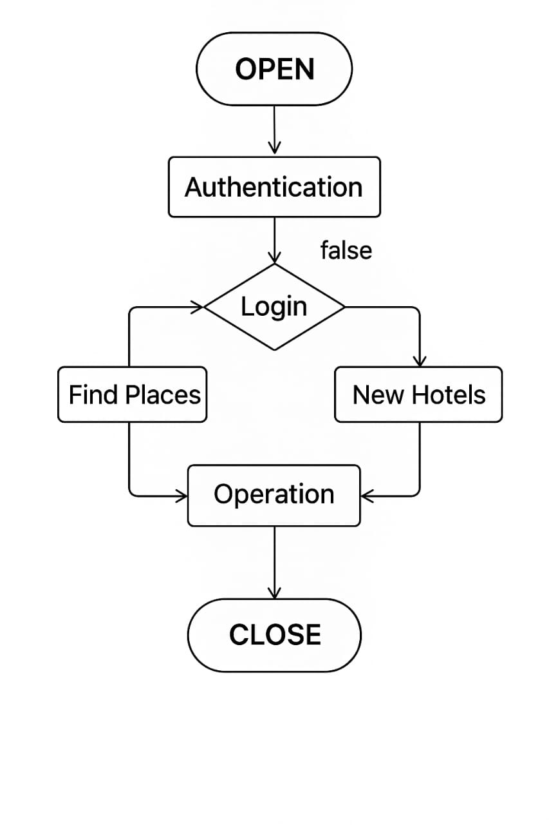
4.0 Flowchart

Slide 8
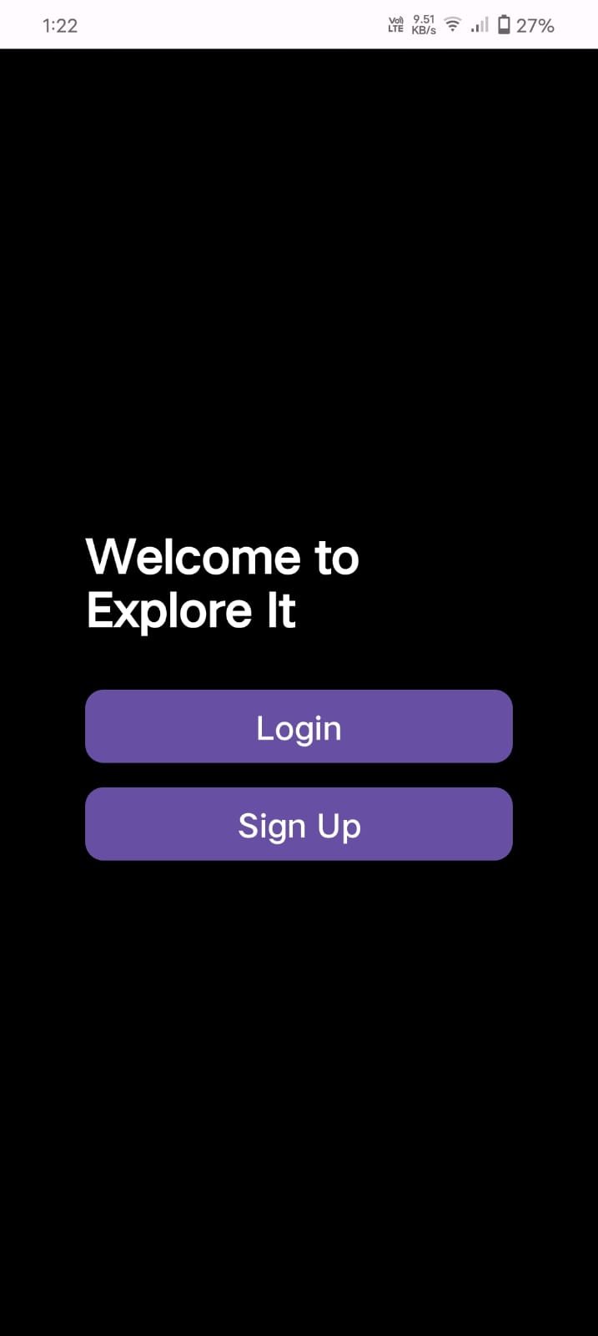
5.0 Working
This is the first interface experiences the user while using the app an explore it
If the use already have an account in the explore it app then the user can simply click on the login button then directed to the next page
If the user does not have any account in the explore it app then the user can press (or) click the button Sign Up button then the user can directed to the next page for the sign up

Slide 9
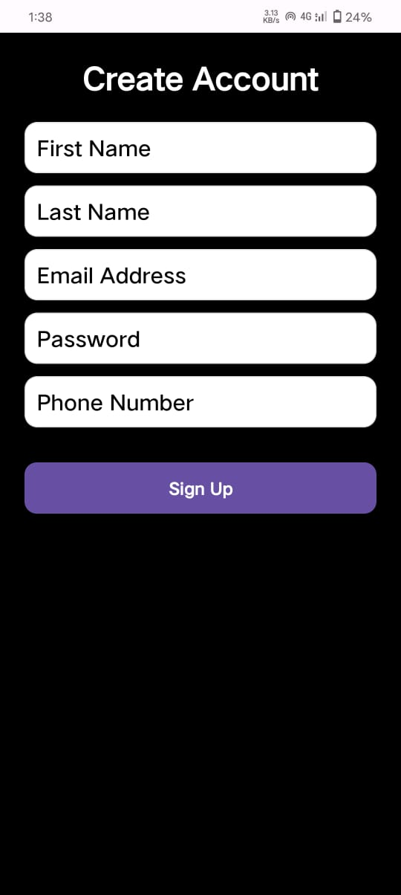
If the user don’t have an account the user wants to create an account in the explore it the interface will be display on the screen
If the user want to create an account then user enter the details like they display.
The details entered by the user the details are stores in the database. In database we created a table with the columns firstname,Lastname,EmailAddress,Password,PhoneNummber.
After entering of all details in the give interface then click the Sign Up button.
firstname | Lastname | EmailAddress | Password | PhoneNumber
As we see the sample of the database table :

Slide 10
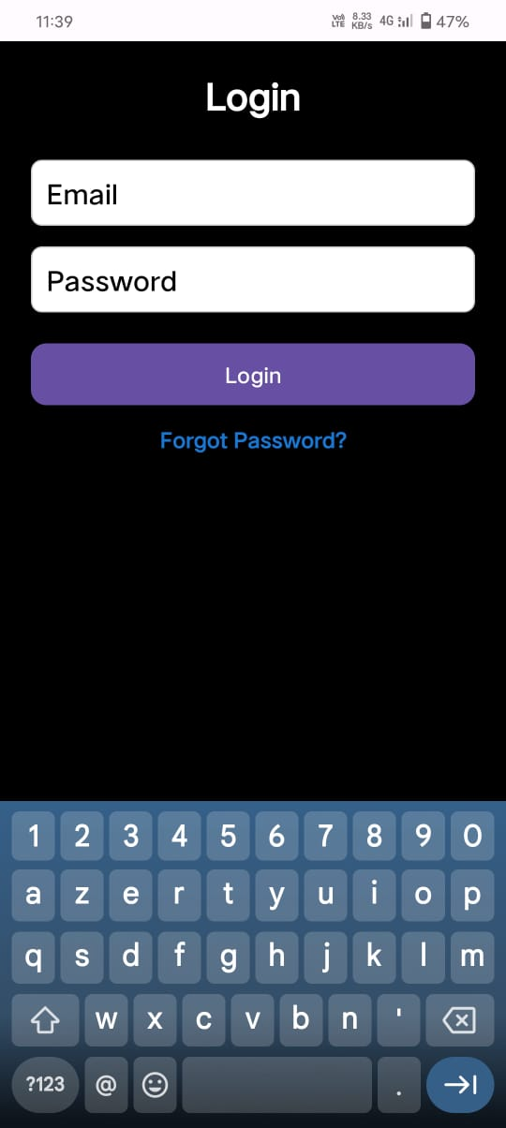
If the user want to log in then the user can simple enter the already registerd email Id and Password is at the time of registration the user used one.
The given data is matched with registered data then only the user can access to go through the further. If any case of the data could not matched the data it will through an error and suffers to move to further
There is a chance of forgetting the password there is an option to change the password

Slide 11
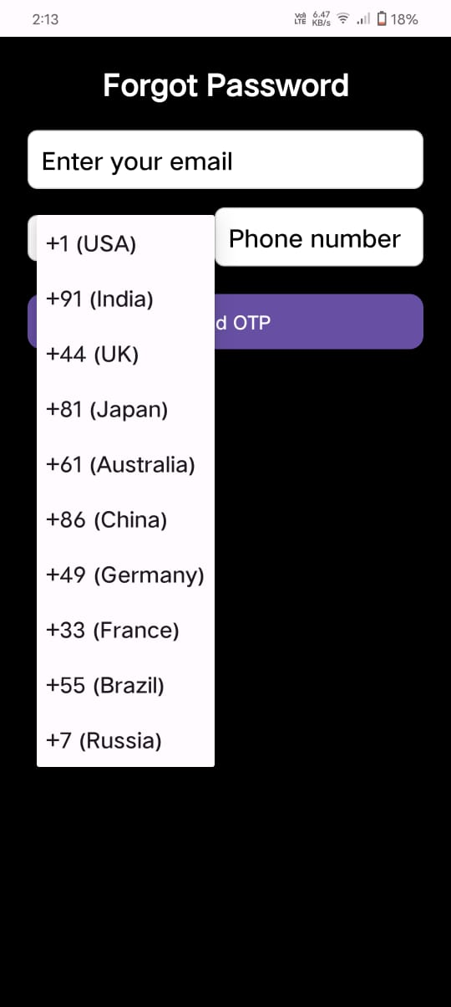
In forgot page before you change the password you must verify your details for the security purpose.
For the verify your details you can enter your email address and your mobile number.
After that the user can press on the send otp button . The server will helps to send opts twilo
To the mobile numbers
In database fetch the mobile number for conformation of the availability of the detailes if there is an available then you can access to enter the otp that send to your mobile number

Slide 12
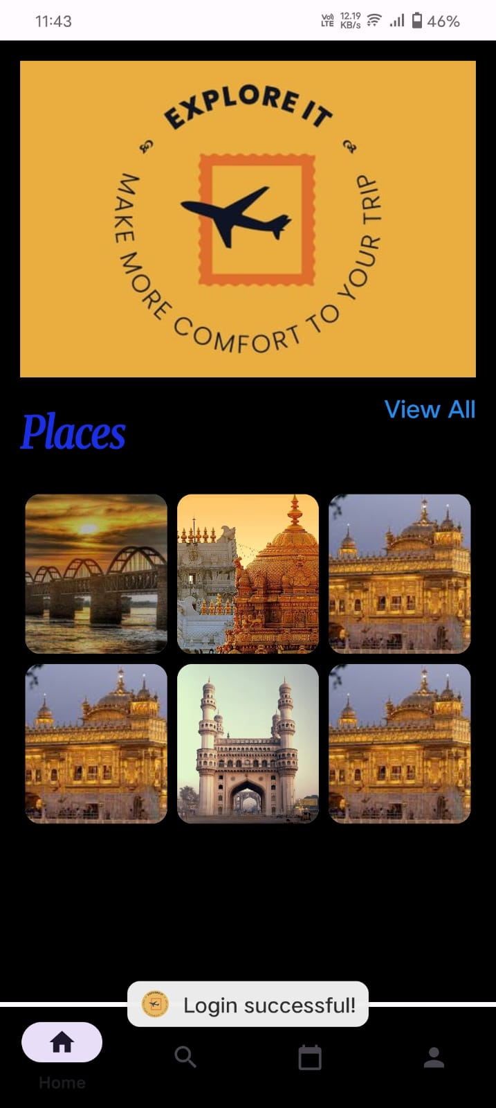
Home page
This is home page in the home page as you see at the at the bottom we there are home navigation ,search navigation ,booking navigation ,and the profile navigation
In the interface there are we add places and hotels and the user wants to give any feed back about the any qiuary we also provide that option also.

Slide 13
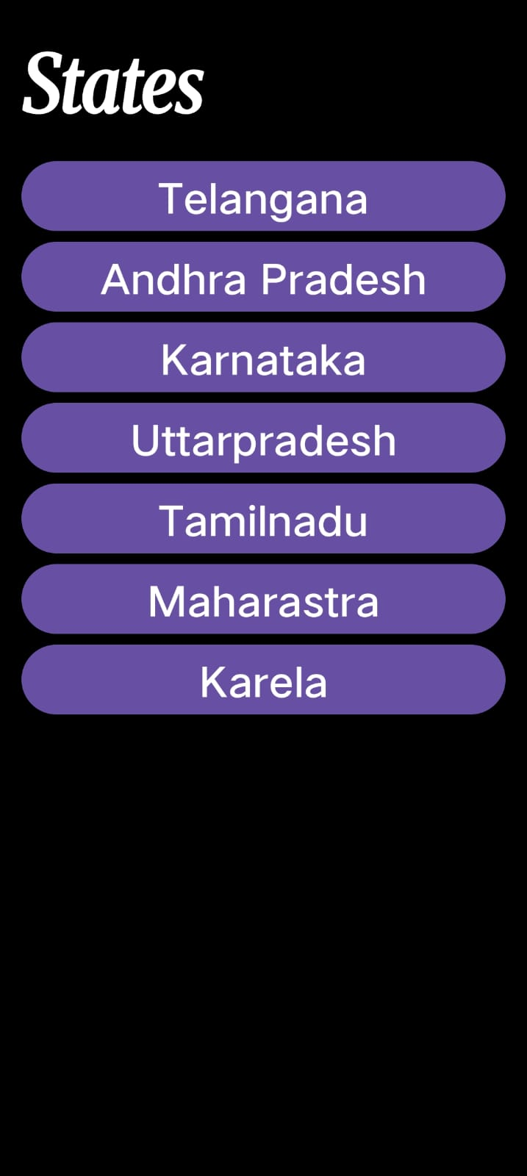
States page
In this states page we see the states in the India this page will helps to the user which state the user wants to explore user can chose

Slide 14
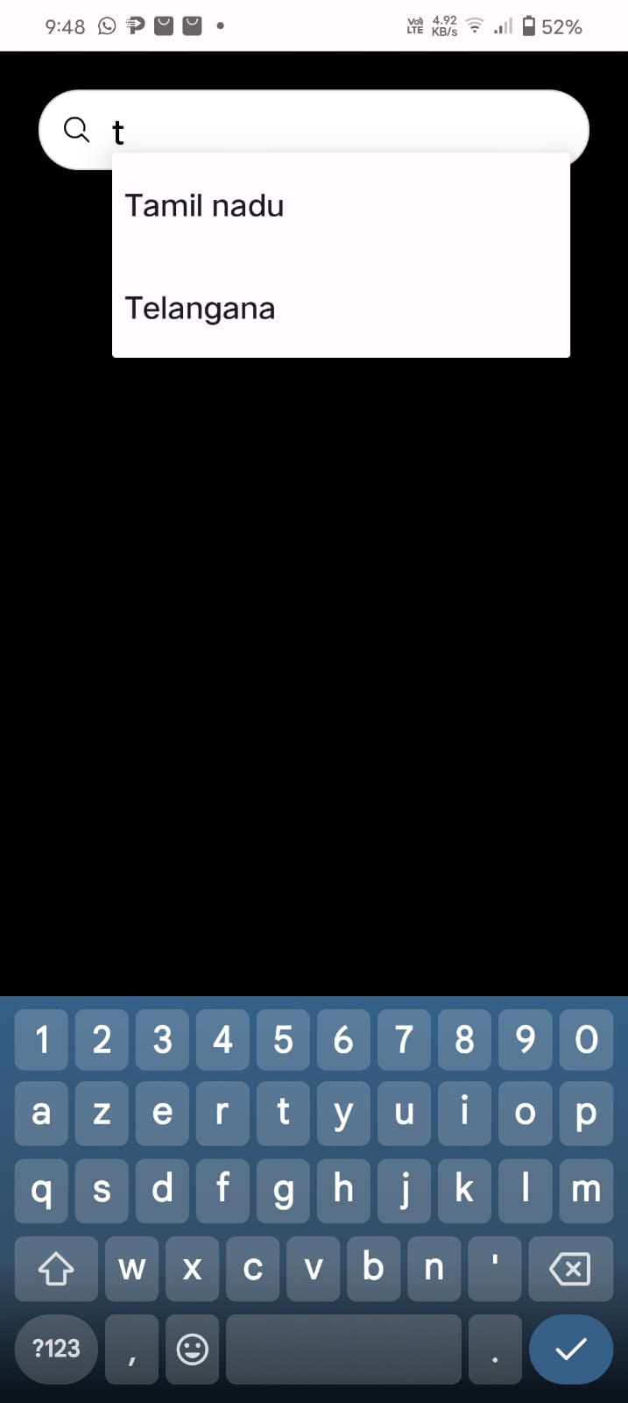
Search engine
If the user can go though the search page this search engine will redirect the states page

Slide 15
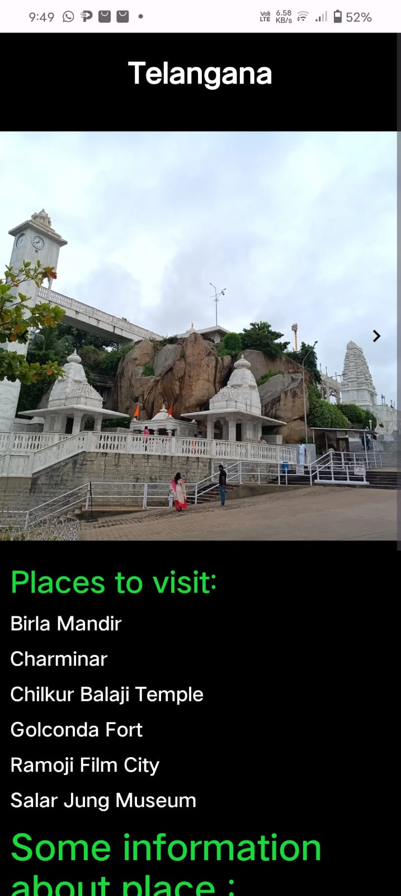
Inside state page
Here the user can choses the Telangana state in side of the Telngana state we see the paces to visit if the user can click on any place then it will redirect the next page , after that n the interface there is some information about the state an the culture of the state.

Slide 16
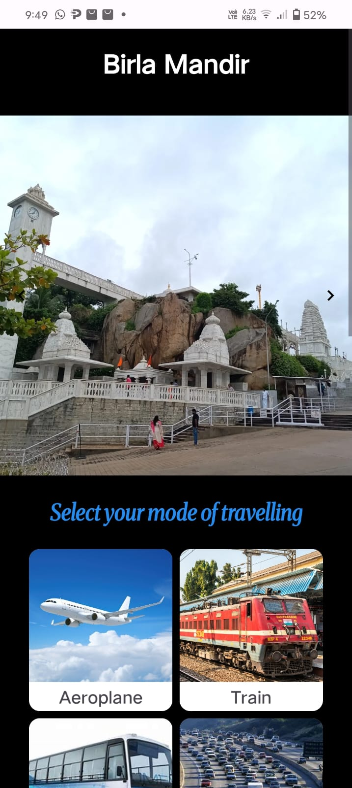
Place to visit
If the user can click on the give list of places the it will redirected to the place of the page .in that interface we seen the list of mode of travelling to reach the chosen destination.

Slide 17
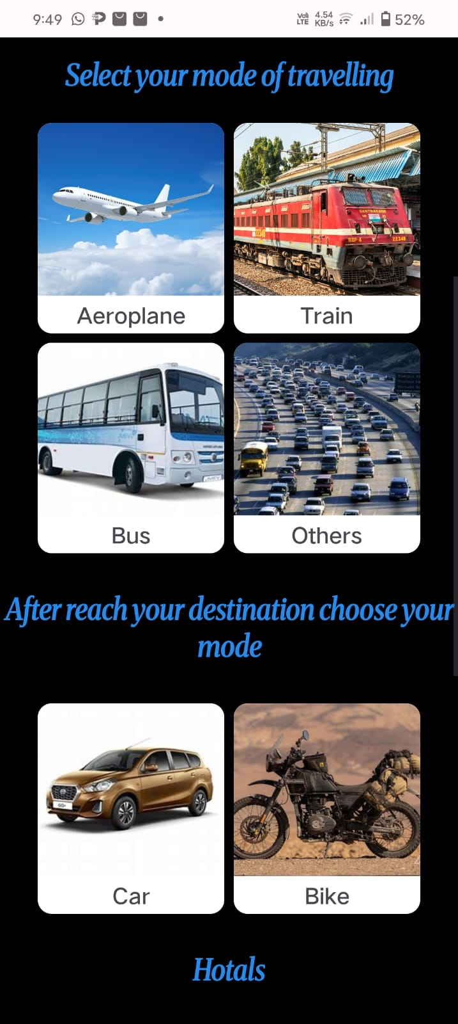
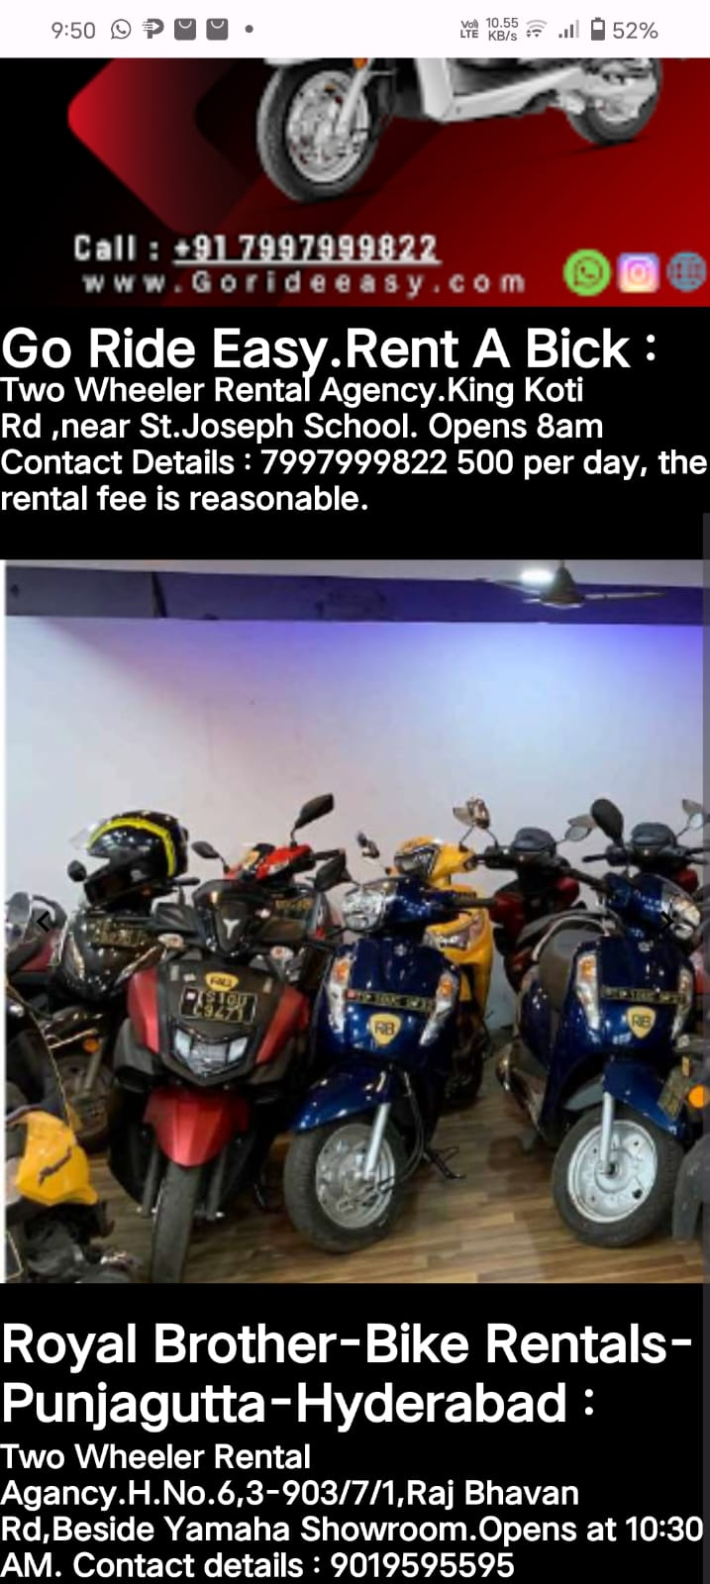
Mode of transport
If the user reach the destination. After rach the destination user can use travel locally via bikes,cars

Slide 18
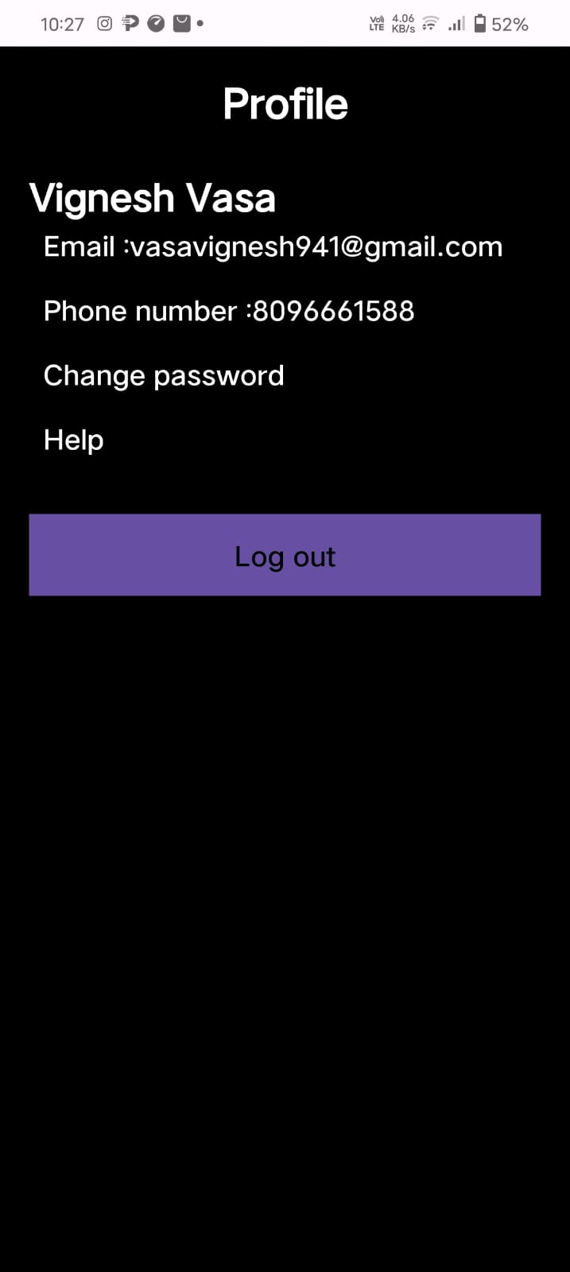
Profile page
In this profile page diplay user details and the log out button for the log out from the user account

Slide 19
references
Flight, Cheap Air Tickets , Hotels, Holiday, Trains Package Booking - Yatra.com
IRCTC Next Generation eTicketing System
Bus Ticket Booking Online at Cheapest Price with Top Bus Operators- redBus
In these reference we used.

Slide 20
END

